Slide 1
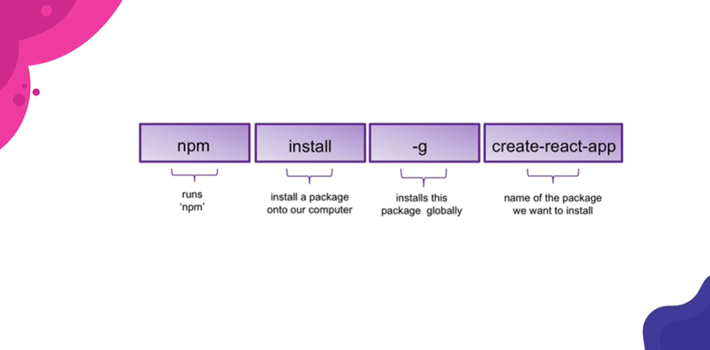

Slide 2
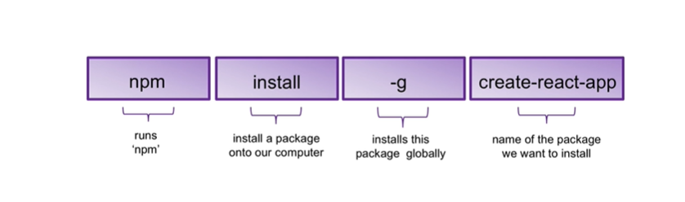
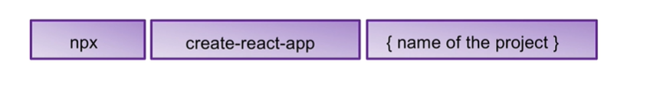

Slide 3
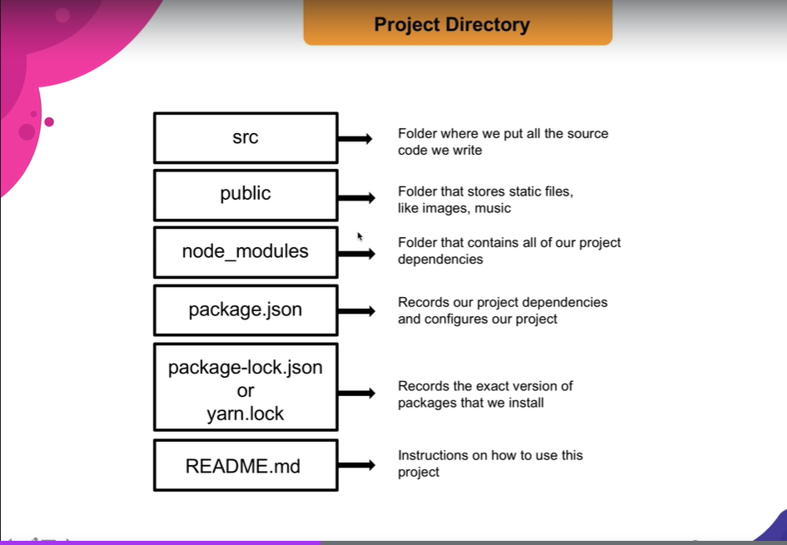

Slide 4
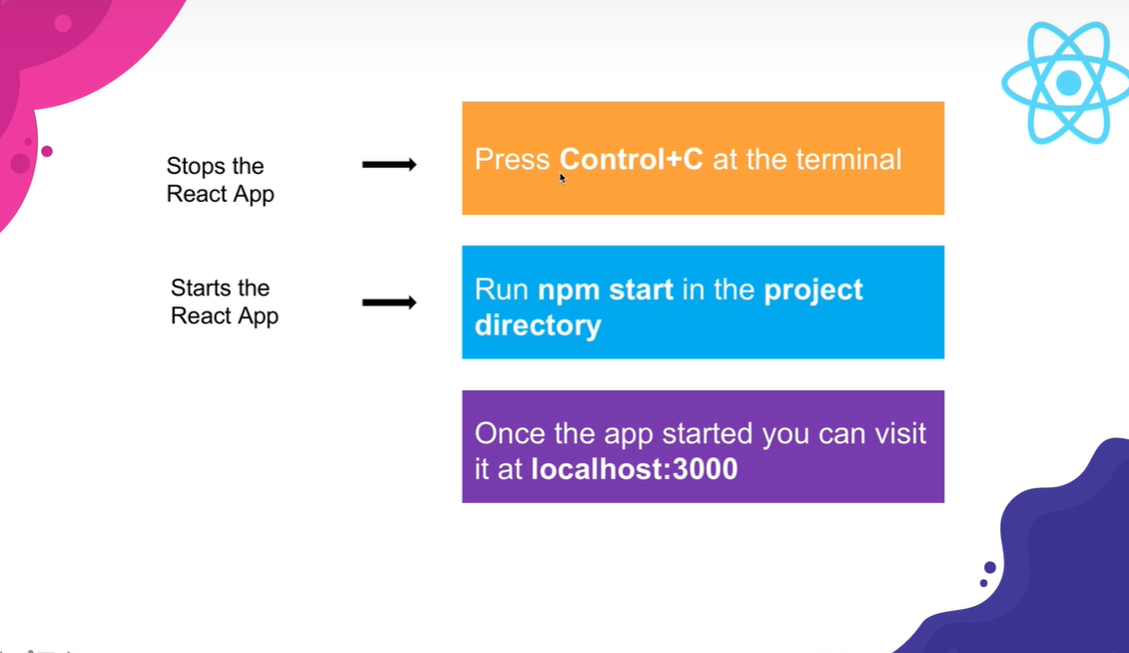

Slide 5
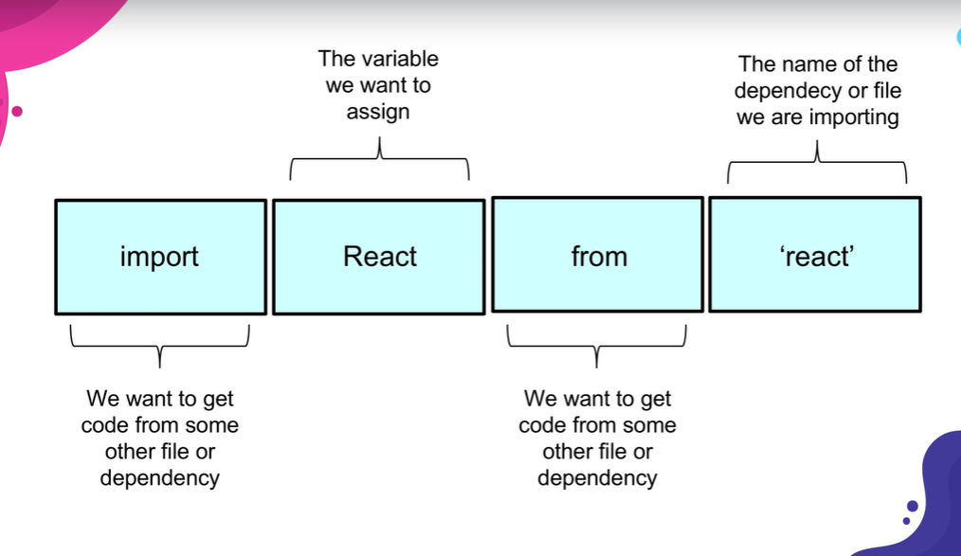

Slide 6
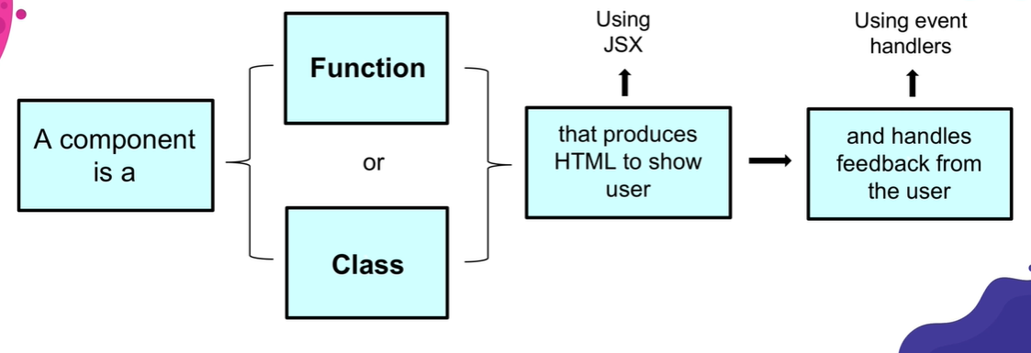

Slide 7
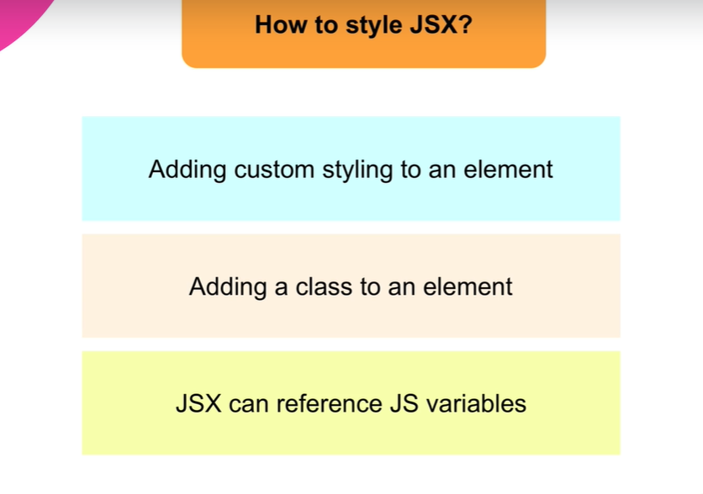

Slide 8
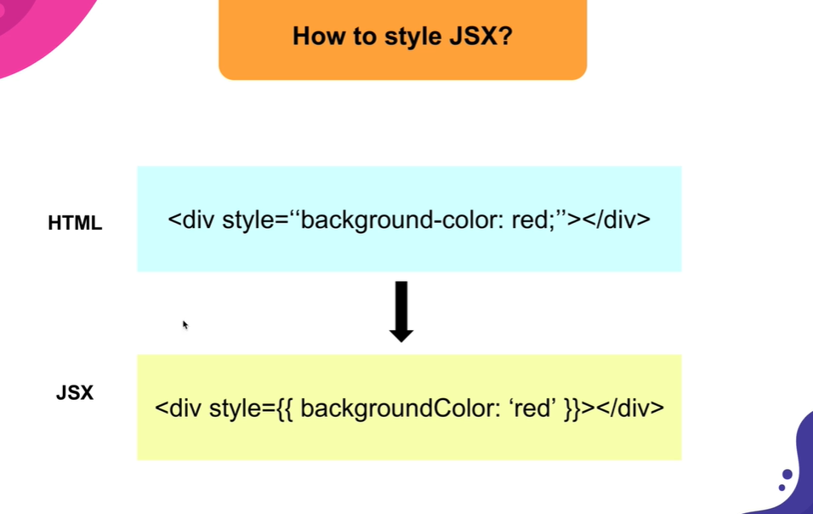

Slide 9
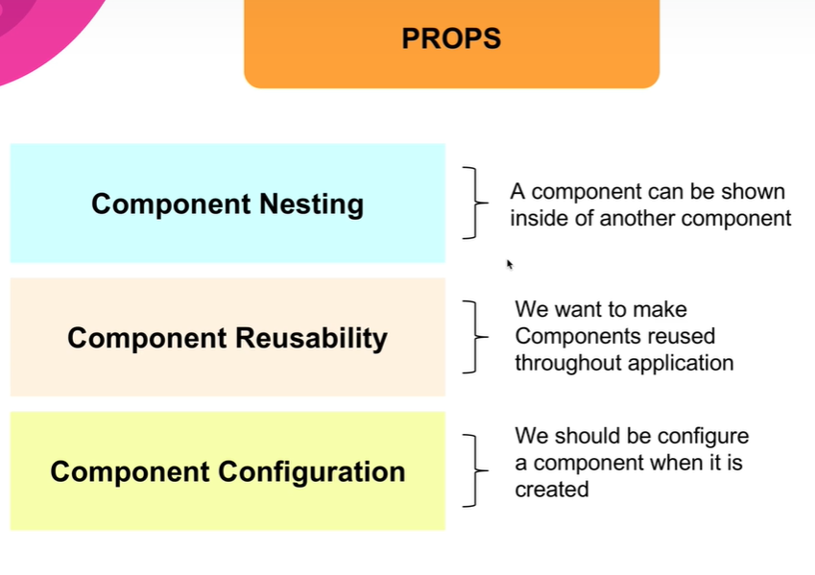

Slide 10
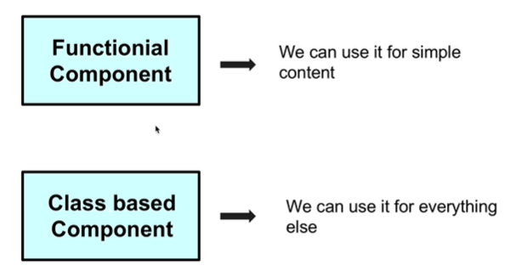
Semantic-ui.com
Not a lot of logic
Simple content
Stick with functional component
Complex logic
Response to user input
Network request use
Class based component

Slide 11
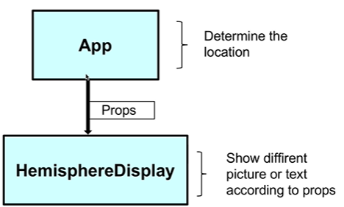
Import React from ‘react’;
Import ReactDom ‘react-dom’;

Slide 12
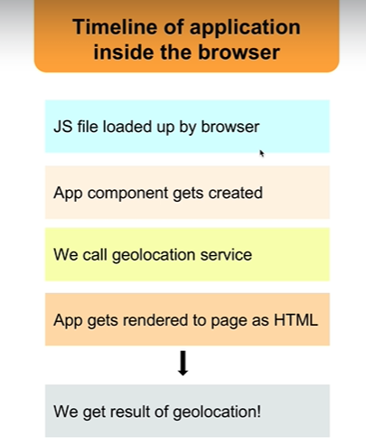
Class based components
Takes time to get back information. The app component (function) will load before the data is transmitted, on possible condition of a call function.
Rules of Class based Components
Must be a JavaScript Class
Must extends React.Component
Must define a ‘render’ method

Slide 13
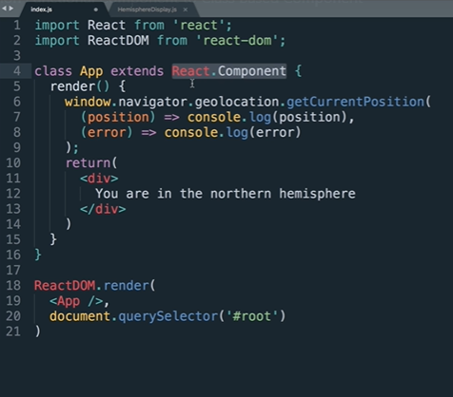

Slide 14
